Slide 1

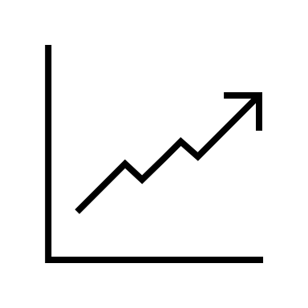
IS6400:
Business Data Analytics
Time Series II: AutoReg

Slide 2
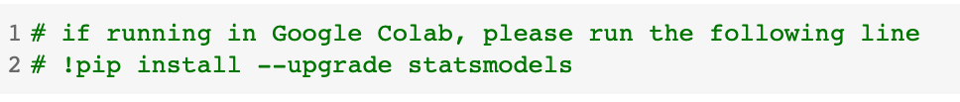
Before class
Homework is available!
Week 6 redo:
Same materials but with slides
Recordings are available
When using Google Colab, we need to update “statsmodels” (code included in the notebook):

Slide 3
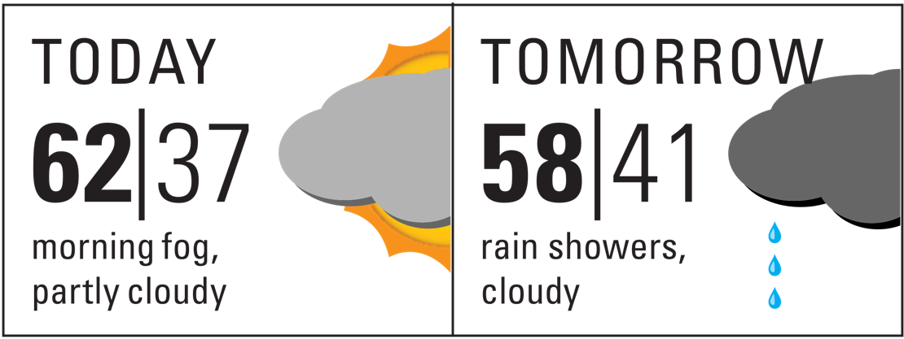
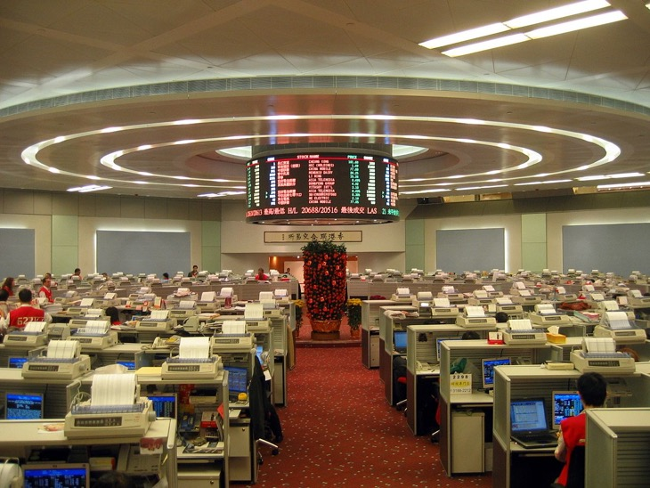
Forecasting
Notes:
In the business context, forecasting is commonly adopted across various scenarios.
In finance, one usually find it important to make use of forecasting tools to help predict the future stock or cryptocurrency values to make profits.
In operations management, it is critical to accurately manage inventory to avoid excessive storage cost due to misprediction of demand from the customers.

Slide 4
What we will talk about
Time series features
Exponential Smoothing
AutoRegresison
Week 7
Week 8

Slide 5
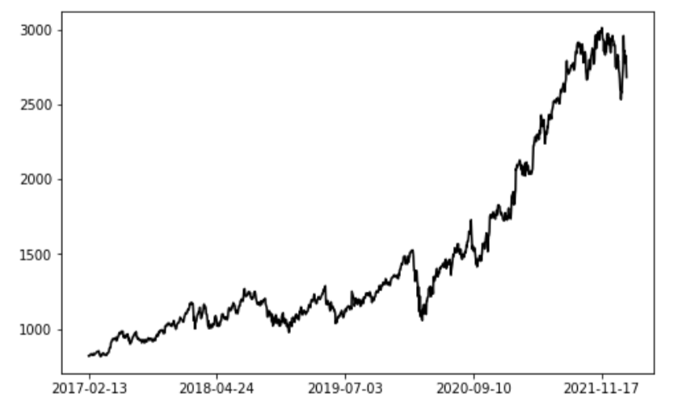
Our journey begins with…
What is time series data?

Slide 6
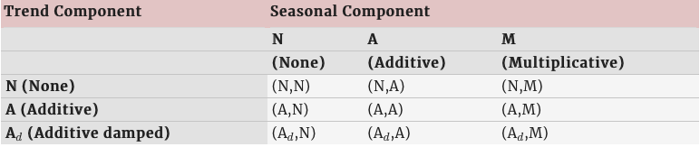
A summary of smoothing
From Table 8.5 of Hyndman and Athanasopoulos (2018)

Slide 7
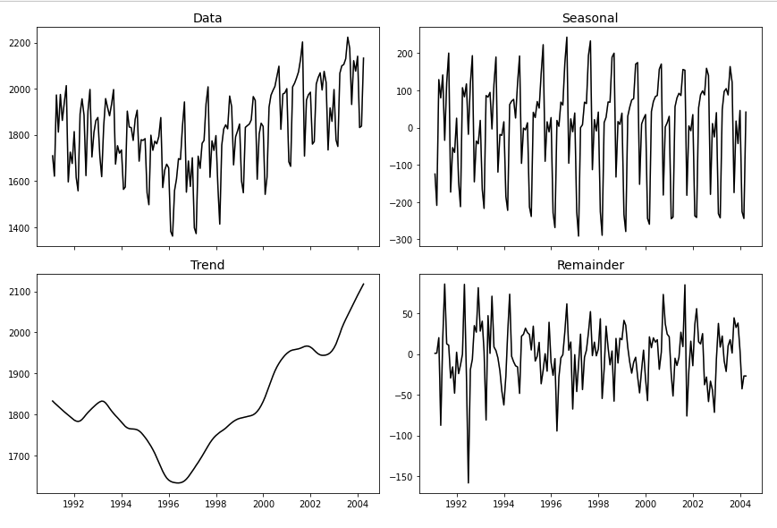
What features did we talk about?
Trend + Seasonality

Slide 8



What features did we talk about?
Autocorrelation:
Correlation with lagged self
$$y_{t}$$
$$y_{t−k}$$
$$k$$

Slide 9
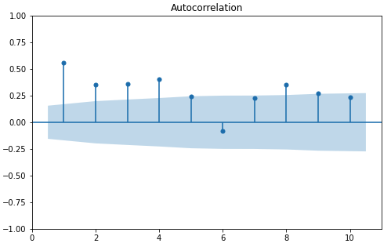
Autocorrelation Diagram
Insignificant corr.
Significant corr.

Slide 10
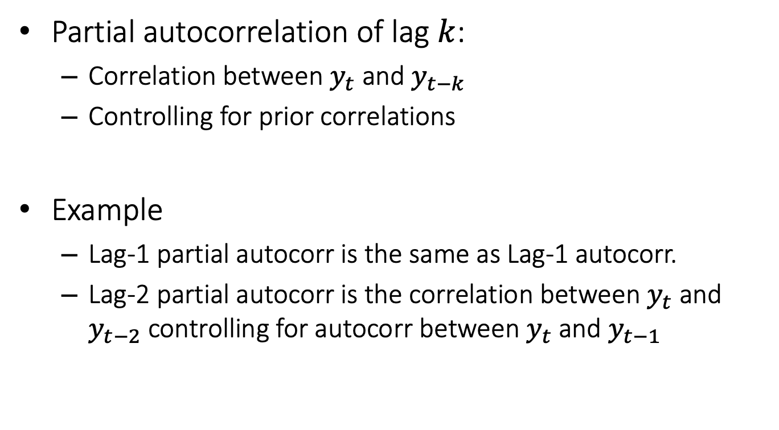
Partial Autocorrelation
Partial autocorrelation of lag $k$:
Correlation between $y_{t}$ and $y_{t−k}$
Controlling for prior correlations
Example
Lag-1 partial autocorr is the same as Lag-1 autocorr.
Lag-2 partial autocorr is the correlation between $y_{t}$ and $y_{t−2}$ controlling for autocorr between $y_{t}$ and $y_{t−1}$

Slide 11
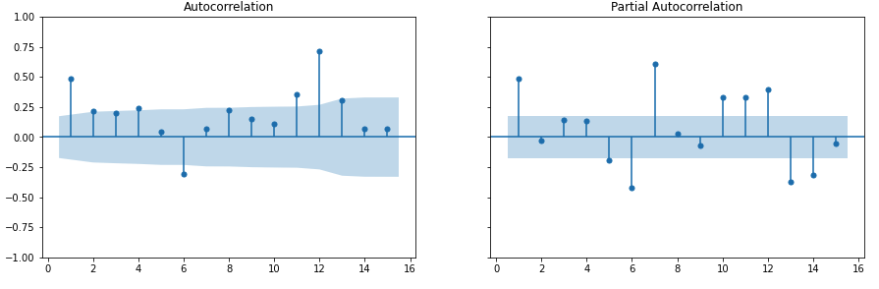
Partial Autocorrelation Diagram

Slide 12

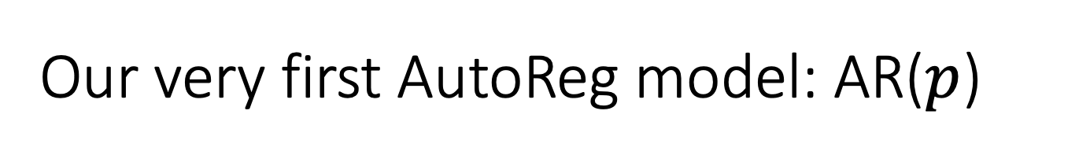
Our very first AutoReg model: AR($p$)
Constant “trend”: like an intercept
Isn’t this familiar? Do you remember the simple exp smoothing method?
Notes:
We may or may be fit constant trend (work like an intercept)

Slide 13
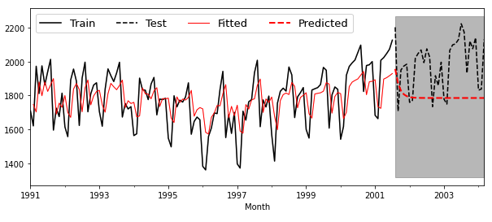
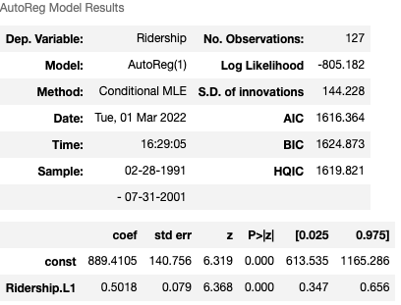

Try it out: Set $p$ to 1

Slide 14
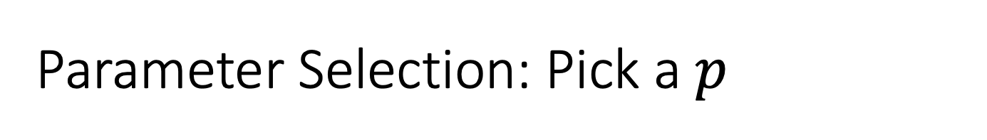
Parameter Selection: Pick a $p$
The interpretations of PACF and AR model coefficients are the same…
The correlation between lagged variables controlling for others…
Then we can just pick a number by looking at the PACF

Slide 15

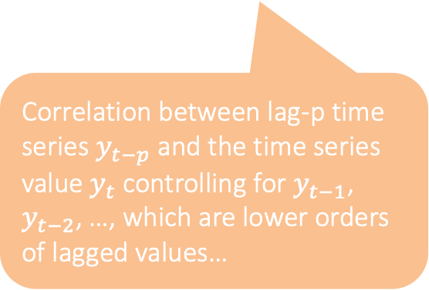
Intuition for the AR identification
How do we interpret linear regression coefficients?
Same for the AR model!
Every one unit increase in “MomIQ” is correlated with 0.56 unit increase in “IQ” controlling for “MonHighSchool”
Correlation between lag-p time series $y_{t−p}$ and the time series value $y_{t}$ controlling for $y_{t−1}$, $y_{t−2}$, …, which are lower orders of lagged values…
This is just the same as PACF for lag-p

Slide 16
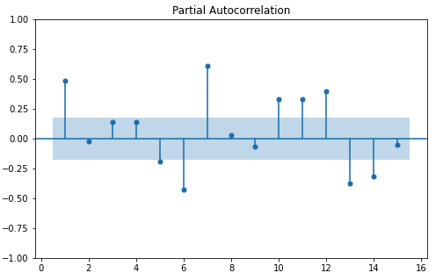
Parameter Selection: Pick a $p$
Either 6 or 7 seem to be alright.

Slide 17
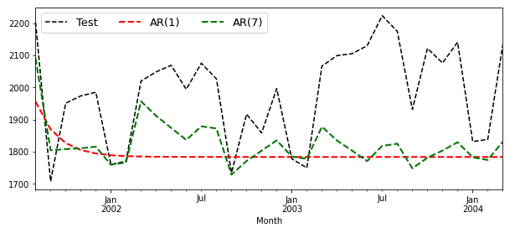
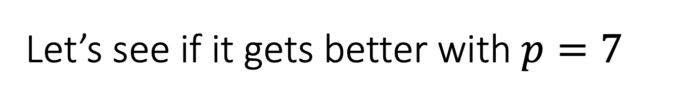
Let’s see if it gets better with $p=7$

Slide 18

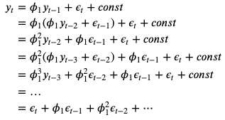

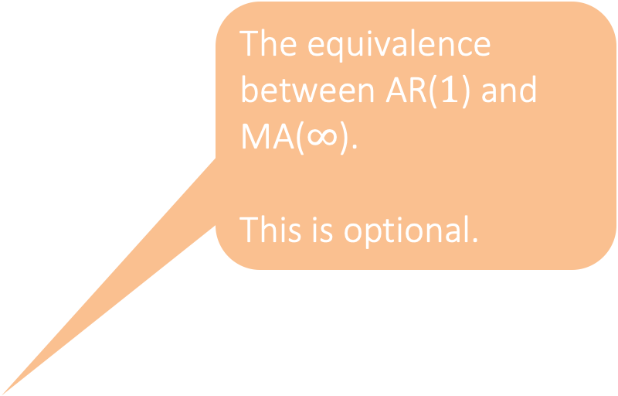
Moving Average: MA($q$)
Intuition: we can forecast future time series values based on our past mistakes
The equivalence between AR($1$) and MA($∞$).
This is optional.

Slide 19
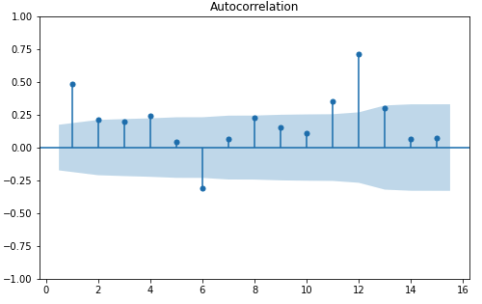
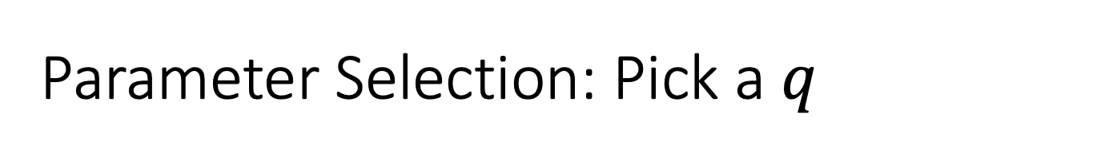
Parameter Selection: Pick a $q$
For this model, we need to look at the ACF (autocorrelation):
Seems like 6 is a good choice
Great explanation: https://youtu.be/_tgB-ri9-8c

Slide 20
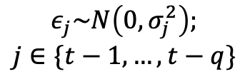



Intuition for MA identification
$$y_{t}=const+θ_{1}ε_{t−1}+θ_{2}ε_{t−2}+θ_{3}ε_{t−3}+…+θ_{t−q}ε_{t−q}$$
$$ε_{j}\sim N\left(0,σ_{j}^{2}\right);$$
$$j∈\{t−1,…,t−q\}$$
This tells us that the predictors in this MA model are independent!
$$θ_{j}$$
$$ε_{j}=y_{j}−\hat{y_{j}}$$
$$Corr(y_{t},y_{j})$$
The coefficient is essentially the correlation between these two lagged series, which is therefore ACF!

Slide 21
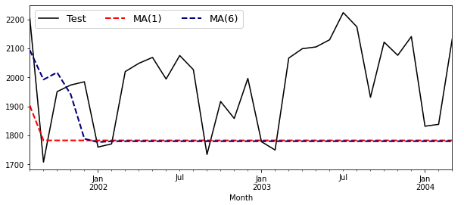
Parameter Selection: Pick a $q$
Compare performance with different parameters for the MA model.
Slightly better.

Slide 22

ARMA: The combination of AR and MA
Intuition: we can forecast future time series values based on past patterns.
Intuition: we can forecast future time series values based on past patterns.

Slide 23
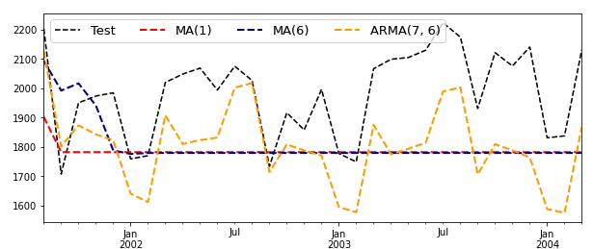
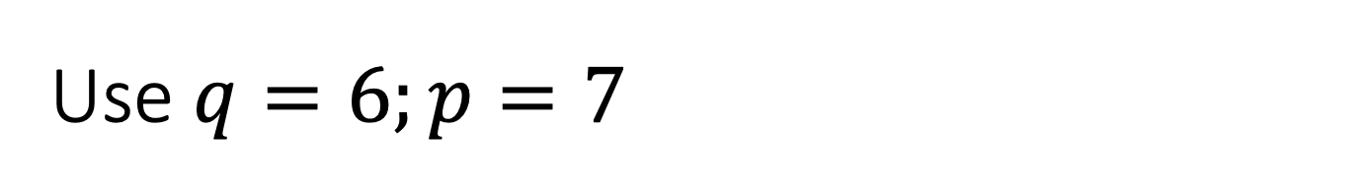
Use $q=6;p=7$
Much better!

Slide 24
Well, what else can we add to ARMA?
Did we talk about trend? Not yet!
Is our dataset stationary?
In fact, most real-world time series datasets are non-stationary!

Slide 25
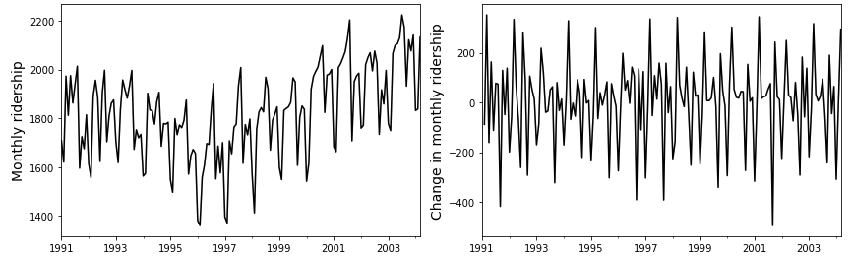

Stationarity and Differencing
Which one is stationary?
Lag-1 differencing: De-trend!
Check p-value of the KPSS test!

Slide 26
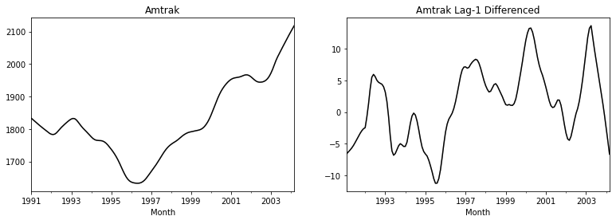
Compare the trend component
Trends by STL decomposition

Slide 27

How about we add this to ARMA?
AR-I-MA, where “I” is for “integrated”, the reverse of differencing
Differenced time series values

Slide 28
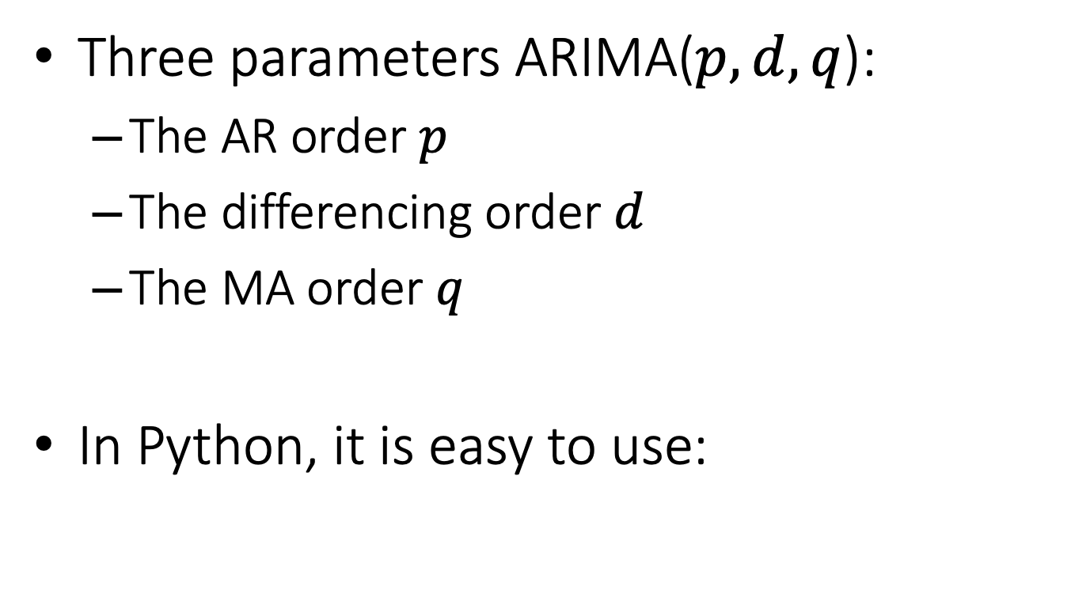
ARIMA: The Final Model
Three parameters ARIMA($p,d,q$):
The AR order $p$
The differencing order $d$
The MA order $q$
In Python, it is easy to use:

Slide 29
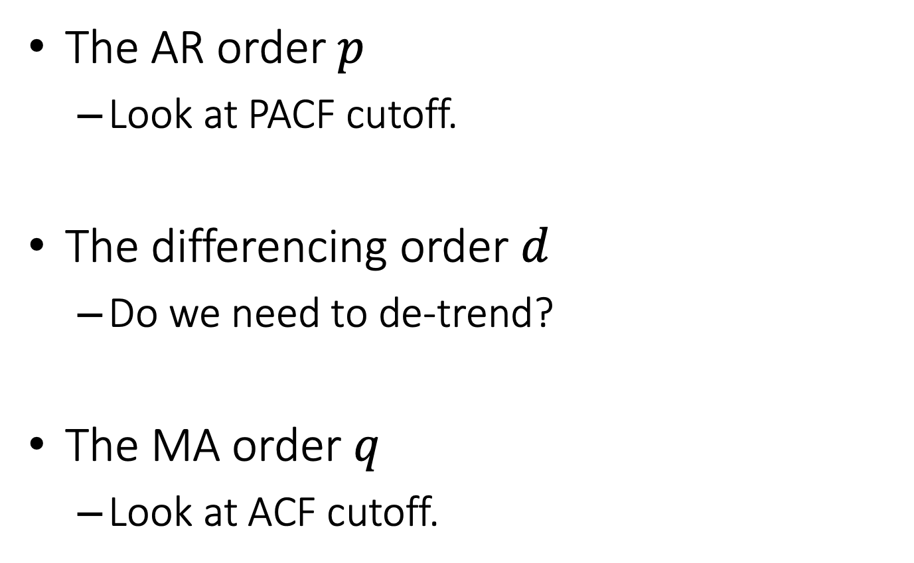
ARIMA: Parameter Selection
The AR order $p$
Look at PACF cutoff.
The differencing order $d$
Do we need to de-trend?
The MA order $q$
Look at ACF cutoff.
Sometimes we may even need double differencing!

Slide 30
ARIMA identification in practice
What does this figure tell us?
(which parameter(s) can we decide?)

Slide 31
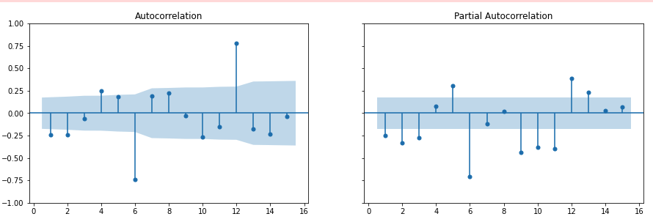
ARIMA identification in practice
The ACF and PACF of the differenced (if any) time series
What does this figure tell us?
(which parameter(s) can we decide?)

Slide 32
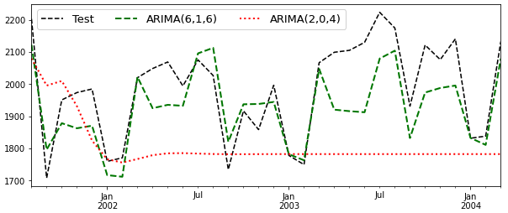
ARIMA Demo
Hand-picked model
Arbitrarily determined parameters

Slide 33
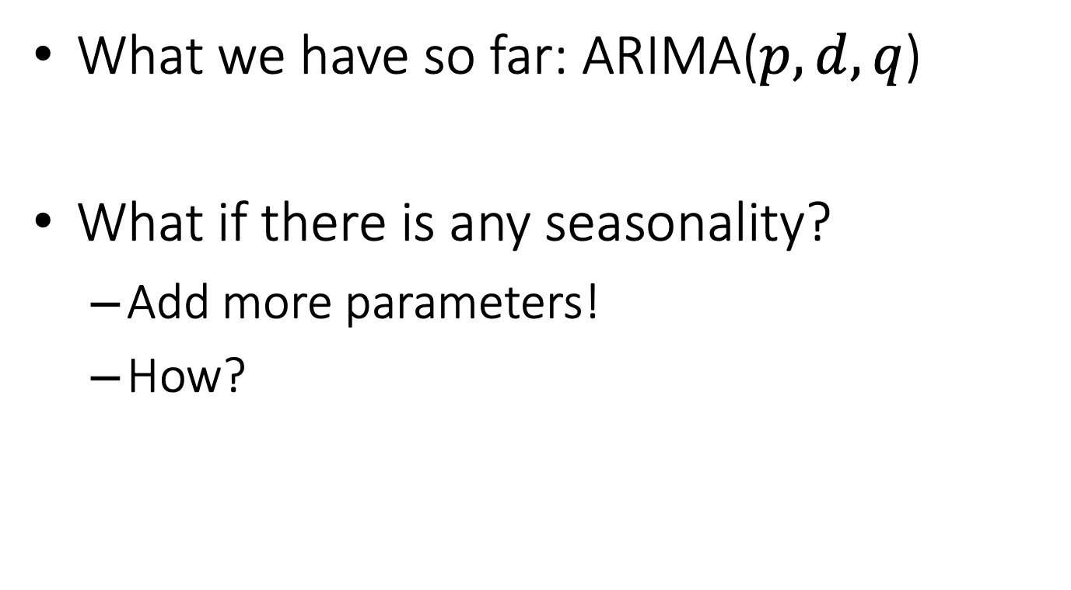
Advanced Topics: Seasonal ARIMA
What we have so far: ARIMA($p,d,q$)
What if there is any seasonality?
Add more parameters!
How?

Slide 34
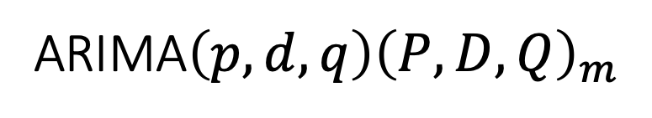

Advanced Topics: Seasonal ARIMA
Add seasonal parameters to ARIMA($p,d,q$)
The meta model:
ARIMA$\left(p,d,q\right){\left(P,D,Q\right)}_{m}$
These are similar to the previous parameters but focus on seasonal components!

Slide 35
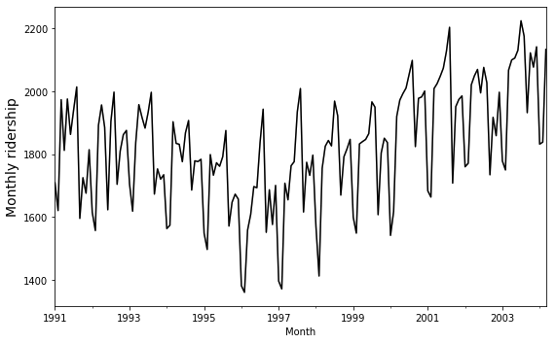
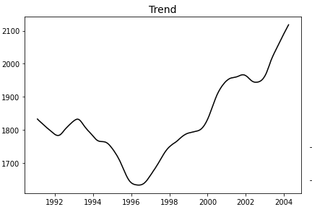
Again: the Amtrak ridership data
There is a trend… We can de-trend by lag-1 differencing…
Notes:
Lag-1 differencing: De-trend!

Slide 36
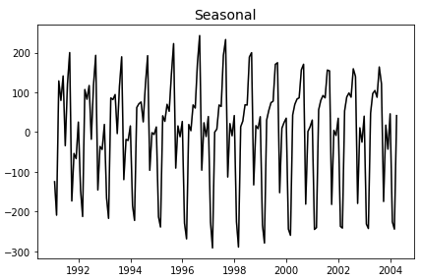
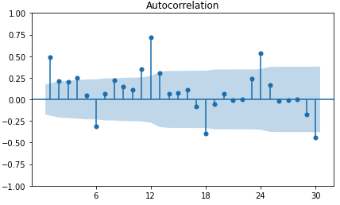
There seems to be having a 12-month periodic cycle, i.e., seasonality
We could do lag-m differencing to de-seasonality!

Slide 37
Over-differencing
Currently, we find a need for double differencing:
At the level of lag-1 to de-trend
At the level of lag-12 to de-seasonality
But we do not want to do over-differencing.
If the lag-1 autocorrelation is -0.5 or more negative, the series may be over-differenced.
BEWARE OF OVERDIFFERENCING!!
https://people.duke.edu/~rnau/411arim2.htm

Slide 38
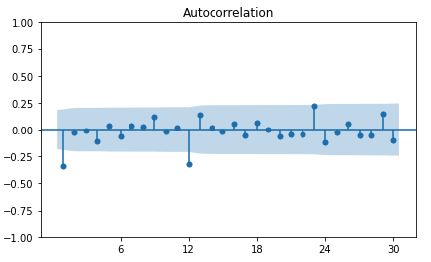
Over-differencing?
This is a lag-1 differencing plus a seasonal differencing (m=12)
Not -0.5 but still… We want to do less differencing…

Slide 39
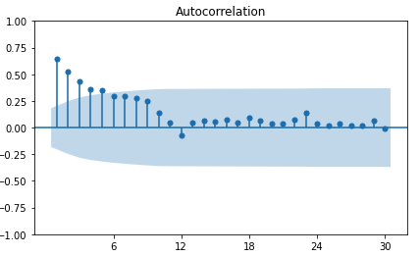
Now let’s just do seasonal diff…
Lag-1 differencing only.
This is better – seasonal diff results in fast decreasing autocorrelation…

Slide 40
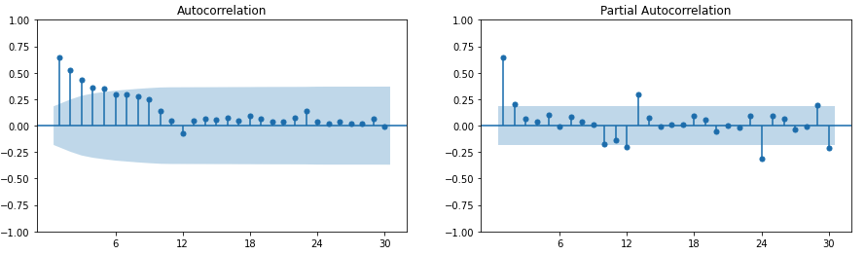
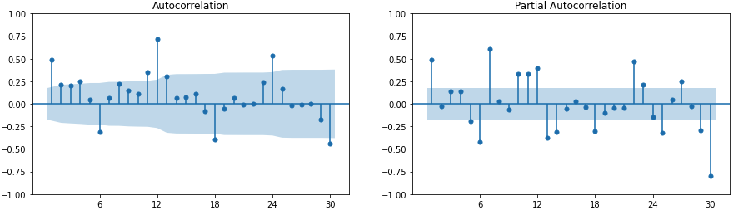
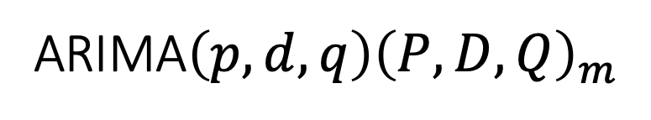
Seasonal differenced series.
No m-level pattern.
ARIMA$\left(p,d,q\right){\left(P,D,Q\right)}_{m}$
What is “m” here?
Any diff?
Any seasonal diff?
Original series

Slide 41
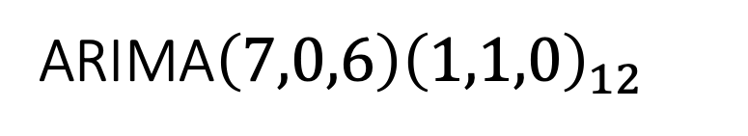
Seasonal differenced series.
ARIMA$\left(p,d,q\right){\left(P,D,Q\right)}_{m}$
ARIMA$\left(7,0,6\right){\left(1,1,0\right)}_{12}$
Original series

Slide 42
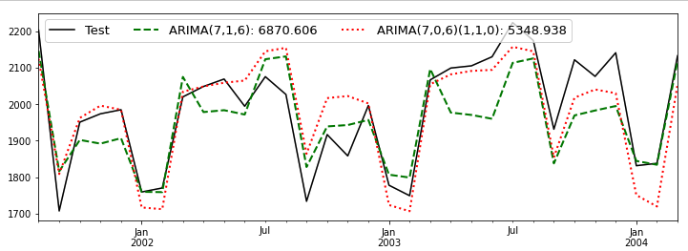
Is it good?
A lower MSE!

Slide 43

Advanced Topics: Vector AutoReg
When we have multiple time series values, what should we do?
They may affect each other: Endogenous

Slide 44
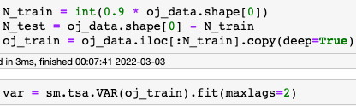
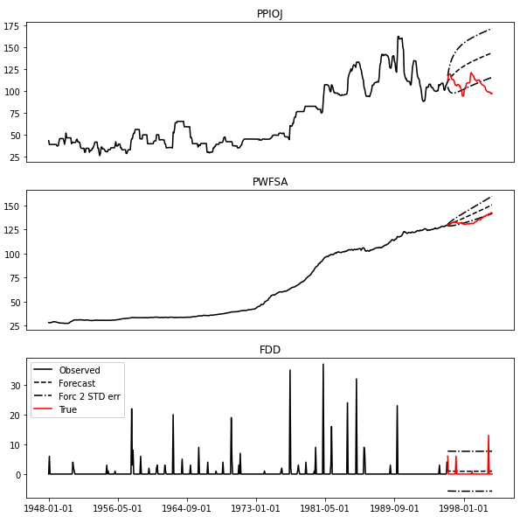
Easy to do with statsmodels!

Slide 45
Suggested References
Hyndman, R.J., & Athanasopoulos, G. (2021) Forecasting: principles and practice, 3rd edition, OTexts: Melbourne, Australia. OTexts.com/fpp3.
Nau, R. (n.d.) Statistical forecasting: notes on regression and time series analysis https://people.duke.edu/~rnau/411home.htm
Business analytics using forecasting: https://youtube.com/playlist?list=PLoK4oIB1jeK0LHLbZW3DTT05e4srDYxFq

Slide 46

The End

